Slide 1
NBA Win Shares
By: Omar Dukureh
Machine Learning with Player win shares

Slide 2
Overview
Used Xgboost to estimate player win shares, a stat that measures players overall impact on winning games
This will help us answer questions like:
Which players are expected to improve?
Which stats matter most for winning?
This can impact how fantasy players draft their rosters, how teams can improve by trades and how coaches can make better decisions on player rotations.

Slide 3
Data Description
Project used Historical data from 2018 - 2025
Data Source | Basketball Reference
Target Variable | Win Shares
Features used | VORP (Value over Replacement Player) , FG (Field goals made), TRB (Total Rebounds), FTA(Free Throws Attempted), MP(Minutes Played), GS (Games Started) , PTS (Points), G(Games Played), Year
Pipeline | Cleaned and filtered player stats, Selected key features, Trained ML models with the features, Evaluation using test data, Forecasted with chosen model.

Slide 4
Key Findings
1
2
3
Correlation
Multicollinearity
Modeling
Deciding on doing three models and compare results.
Checked Correlation between the target variables and variables in the data set.
Dropped feature candidates that were highly correlated to each other. Kept the one with higher correlation with target

Slide 5
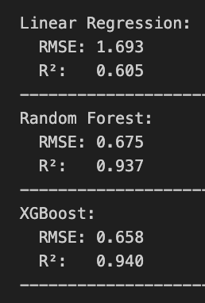
Model Results
Linear regression
Had the highest Root Mean Squared error and R^2
Random Forest
RMSE and R^2 are good.
XGBoost
RMSE and R^2 are the best, so i chose to use this

Slide 6
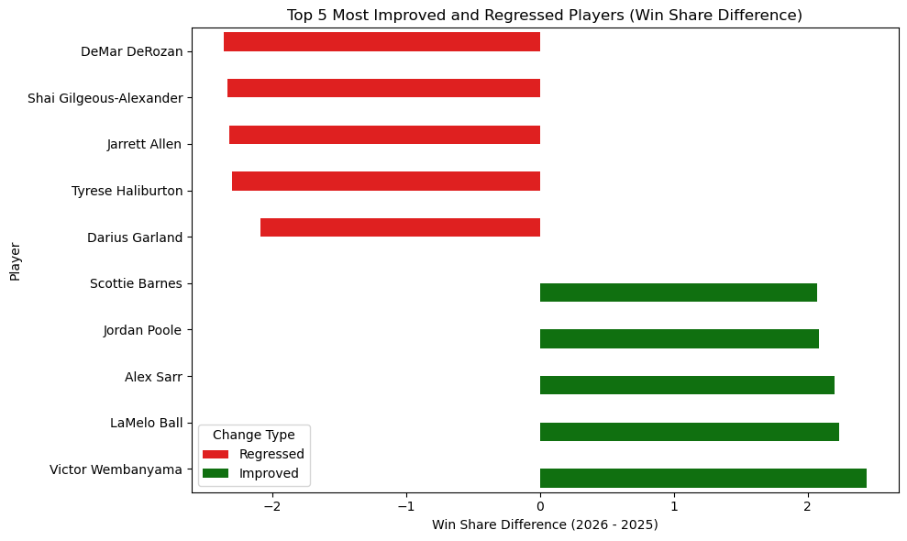
XGBOOST Model Results
Predicted Future WS
Used historical data to forecast player win shares.
Some players are projected to be more impactful to their teams than others.
The Figure on the right shows 5 players who are projected to improve the most vs 5 players who became worse.

Slide 7
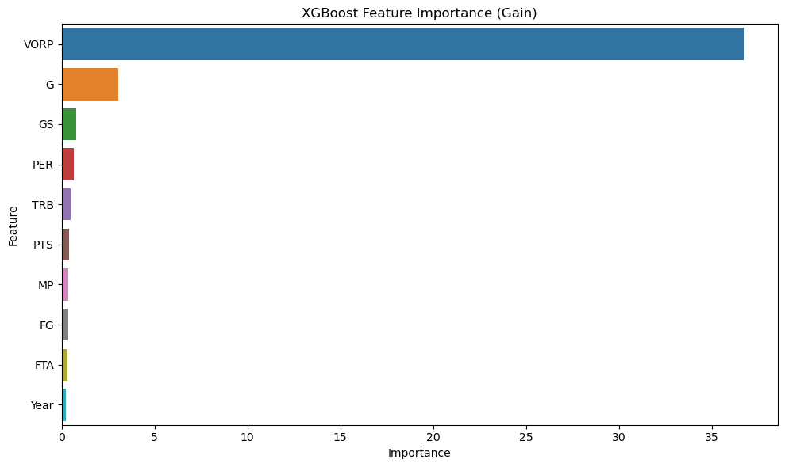
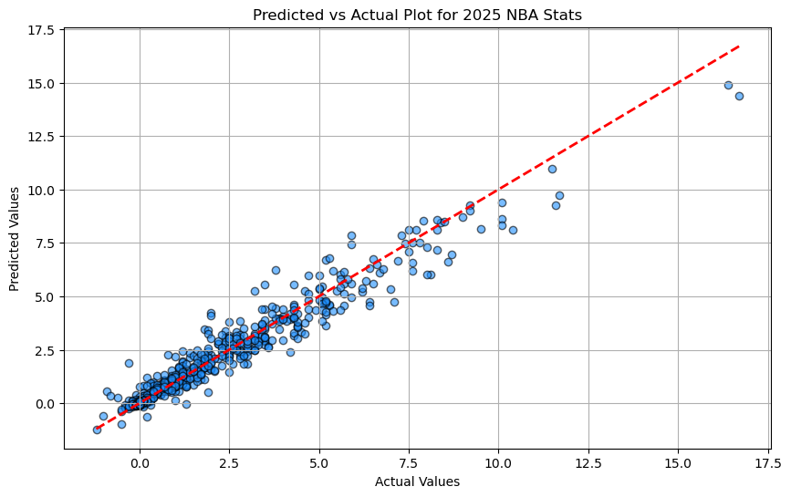
Model Results
Feature importance
Value Over Replacement Player had the most impact in the mode, this is the stat that matter the most when predicting win shares.
Predicted vs Actual Results
The predicted vs actual plot shows a great linear relationship. With some outliers because of star players.

Slide 8
Next Steps
Create a simple software program that allows users to interact with predictions
Account for injuries, Age and other types of variables for predictions

Slide 9
Thank You!
DO YOU HAVE ANY QUESTIONS?

